Slide 1
MANB2153 MACHINE LEARNING FOR BUSINESS PROBLEMS
Siti Sophiayati Yuhaniz
Week 1

Slide 2
Outline
Instructor’s Profile
Course Synopsis and Outline
Assessment
Class Policy

Slide 3
Instructor’s Profile
Dr Siti Sophiayati Yuhaniz
Senior Lecturer
Head of Machine Learning for Data Science SIG
Program Coordinator for MSc (Business Intelligence and Analytics)
Research Interest: Machine Learning, Data Analytics, Image Processing
fb.me/sophiayuhaniz
twitter.com/sophiayuhaniz
ais.utm.my/sophia

Slide 4
Course Outline
Week | Topic
1 | Introduction to Machine Learning Lab: Setting up environment for Python and related dependencies
2 | kNN, Decision Tree, Linear Regression Logistic Regression
3 | Multi-class Classification Artificial Neural Networks
4 | Support Vector Machines K-Means Clustering and PCA
5 | Evolutionary Algorithms Performance Measurements and Validations
6 | Anomaly Detection and Recommendation Systems

Slide 5
Assessment
No | Assessment | %Total
1 | Term Paper | 20
2 | Quiz | 10
3 | Assignment | 20
4 | Observation | 5
5 | Self Reflection | 5
6 | Presentation | 10
7 | Project | 30
Total |  | 100%

Slide 6
Class Policy
Assignment/Labs/Projects
Any late submissions will be penalized 1% of each a day late
Attendance
Class is held at 10.00 am. Attendance is compulsory
Absence will be penalized, unless early notifications
E-Learning Activities
Required activities for assessment.

Slide 7
References
Coursera (Stanford University) Machine Learning: https://www.coursera.org/learn/machine-learning
MIT Open Courseware on machine learning: https://ocw.mit.edu/courses/electrical-engineering-and-computer-science/6-867-machine-learning-fall-2006/
Books:
Christopher M. Bishop, Pattern Recognition and Machine Learning (Information Science and Statistics), Springer; 1st ed. 2006. Corr. 2nd printing edition (October 1, 2007), ISBN-10: 0387310738, ISBN-13: 978-0387310732
Ethem Alpaydin. Introduction to Machine Learning (Adaptive Computation and Machine Learning series). The MIT Press; second edition edition (December 4, 2009. ISBN-10: 026201243X, ISBN-13: 978-0262012430

Slide 8
Machine Learning and Computational Intelligence: The Basic Foundation
Domains and Applications
Essence of Machine Learning
Types of Learning

Slide 9
Introduction
What is Machine Learning?
Have you heard about it?
Do you know about it?
Have you used it before?
Why we need to use Machine Learning?
Where it is being applied?
How it is done?

Slide 10
Introduction
What is Machine Learning?
Why use Machine Learning?
Where it is being applied?
How is it done?

Slide 11

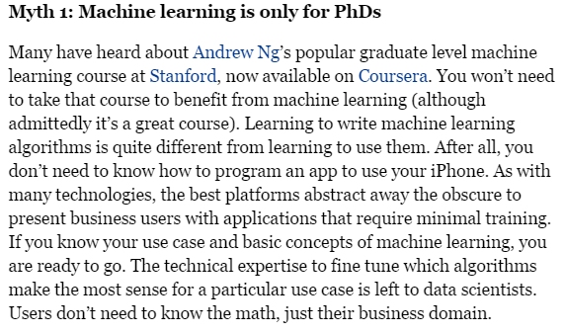
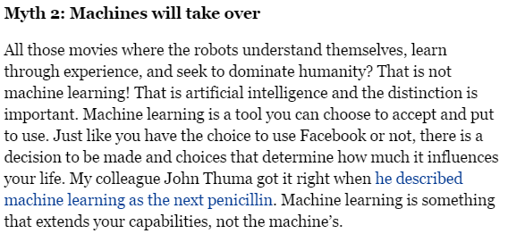
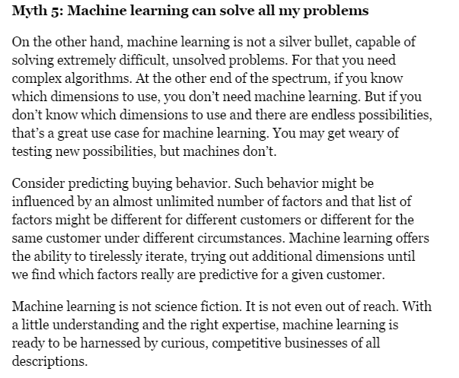
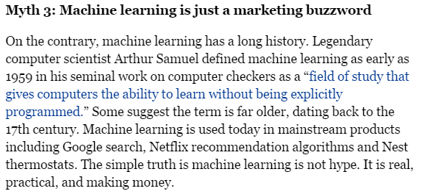
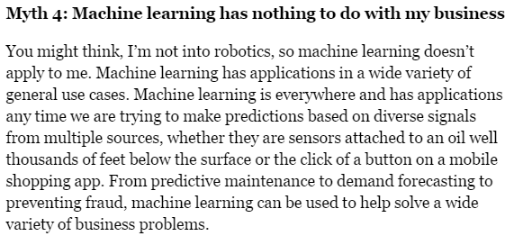

Slide 12
A Few Quotes
“A breakthrough in machine learning would be worth ten (10) Microsoft” (Bill Gates, Chairman, Microsoft)
“Machine learning is the next Internet” (Tony Tether, Former Director, DARPA)
Machine learning is the hot new thing” (John Hennessy, President, Stanford)
“Web rankings today are mostly a matter of machine learning” (Prabhakar Raghavan, Dir. Research, Yahoo)
“Machine learning is going to result in a real revolution” (Greg Papadopoulos, CTO, Sun)

Slide 13

What is Machine Learning?
“Field of study that gives computers the ability to learn without being explicitly programmed”- Arthur Samuel (1959).
Machine learning (ML) is a subarea of artificial intelligence (AI) that provides computers with the ability to learn without being explicitly programmed.
Notes:
Machine learning focuses on the development of computer programs that can teach themselves to grow and change when exposed to new data.

Slide 14
Artificial Intelligence?
AI is a broad field, and means different things to different people. It is concerned with getting computers to do tasks that require human intelligence which require complex and sophisticated reasoning processes and knowledge.

Slide 15
Machine Learning
Deep Learning
Example: MLP (ANN)
Example: Logistic Regression
AI
Representation Learning
Example: Knowledge Bases
Example: Shallow autoencoders
Adapted from: Goodfellow et al. 2016. Deep Learning. MIT Press

Slide 16
IBM’s Deep Blue
Notes:
In 1997, IBM’s Deep Blue defeated Garry Kasparov. Chess is a simple problem with 64 location and 32 pieces that can move. So it’s simple.

Slide 17
Why do you think IBM’s Deep Blue won the game?
Why do you think current robots can’t perform as accurate as human?
Notes:
Computers can be easily programmed to list down all the possible moves and rules. And formal tasks.
However, computers hard to capture intuitive, subjective notions of human that has been captured and evolved along the years.

Slide 18
Knowledge Base AI
Hard coded knowledge in formal languages.
Example: rule-based system, expert system.
The challenge is: how to get the knowledge into computer, especially informal knowledge.

Slide 19
Traditional Programming
Data
Program
Computer
Output
Machine Learning
Data
Output
Computer
Program
Slide credit : Pedro Domingos

Slide 20
Machine Learning
Introduction to ML (NVIDIA DLI slides)

Slide 21
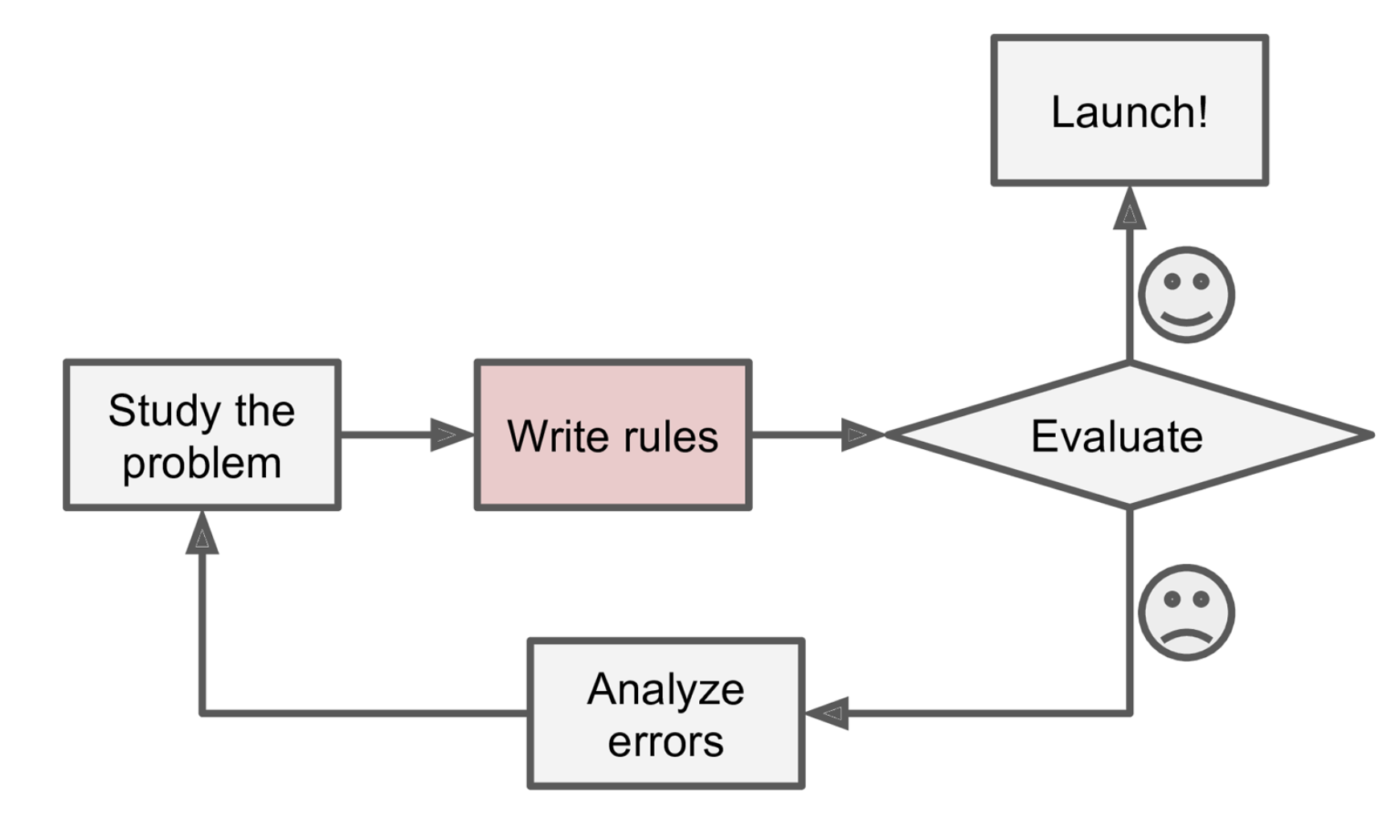
Spam Example: Traditional way
First you would look at what spam typically looks like. You might notice that some words or phrases (such as “4U,” “credit card,” “free,” and “amazing”) tend to come up a lot in the subject. Perhaps you would also notice a few other patterns in the sender’s name, the email’s body, and so on.
You would write a detection algorithm for each of the patterns that you noticed, and your program would flag emails as spam if a number of these patterns are detected.
You would test your program, and repeat steps 1 and 2 until it is good enough.

Slide 22
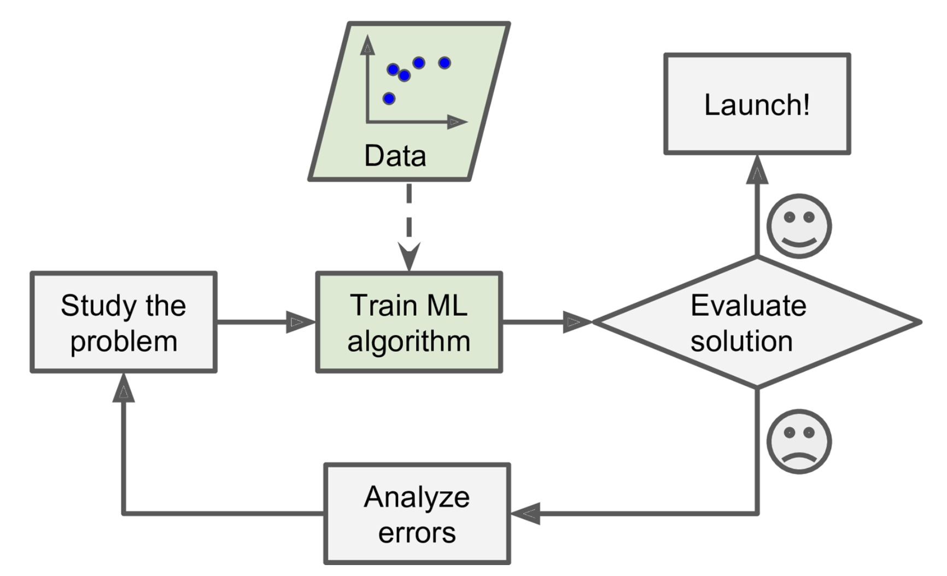
Machine Learning way
In contrast, a spam filter based on Machine Learning techniques automatically learns which words and phrases are good predictors of spam by detecting unusually frequent patterns of words in the spam examples compared to the ham examples

Slide 23
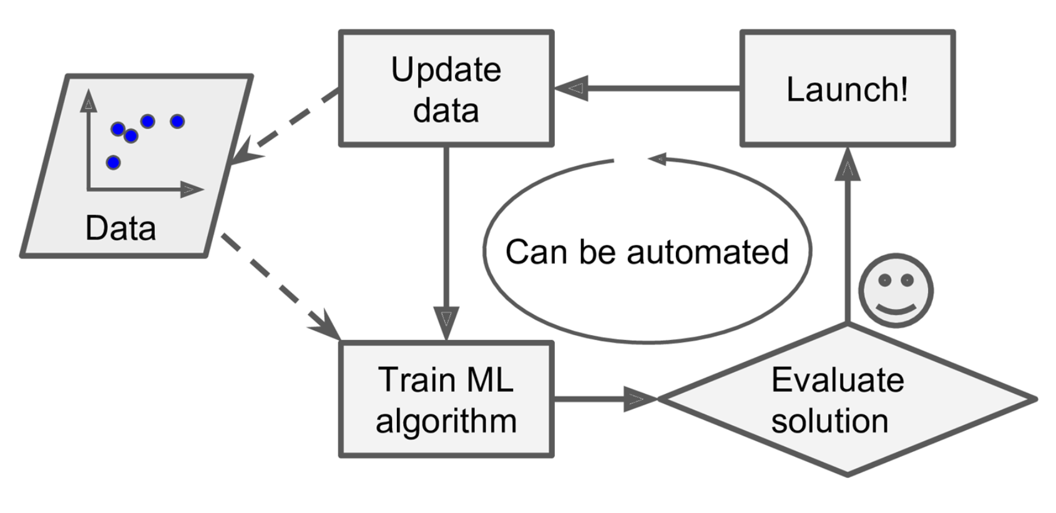
Can be automated
Notes:
Think of Google keyboard

Slide 24
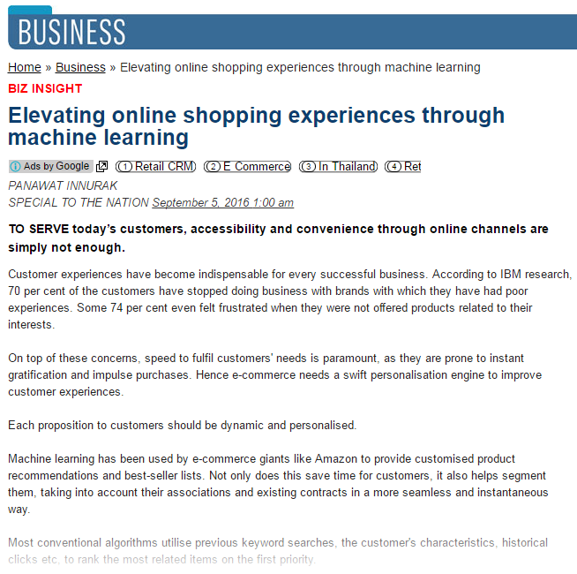
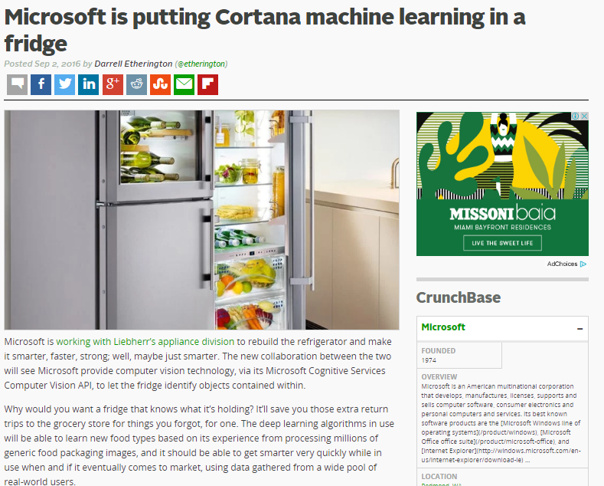
Examples:

Slide 25
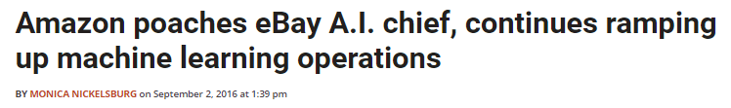
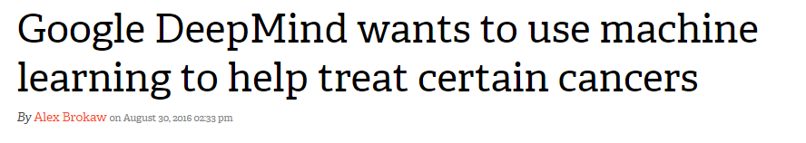
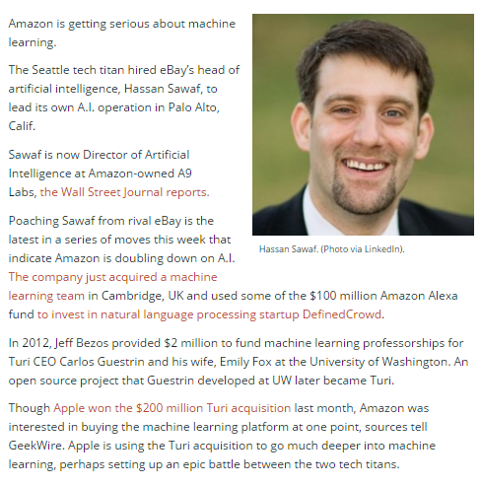
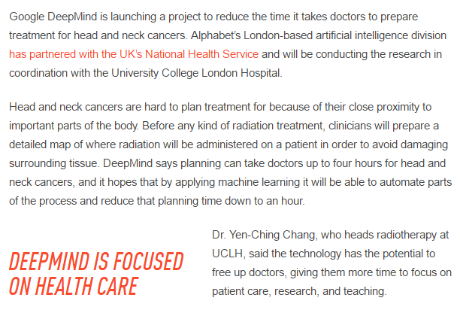
Examples:

Slide 26
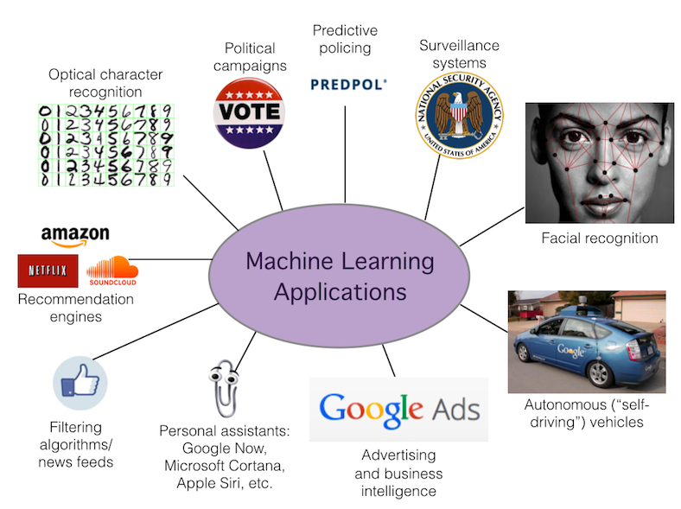
Many domains & applications
Notes:
Areas that influence the machine learning and application:
Vision : say what object appear in an image; convert hand written digits to characters 0-9
Vision : detect where objects appear in an image
NLP : detect where entities are mentioned in NL; detect what facts are expressed in NL; detect if a product/movie review is positive negative or neutral
Stock market $$$ : predict if a stock will raise or fall-in the next miliseconds

Slide 27
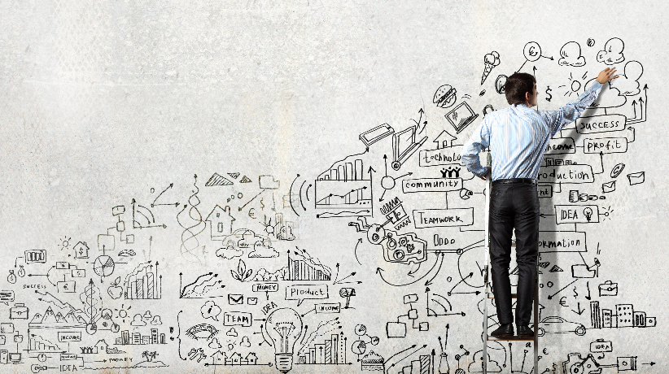
“At the highest level, machine learning is about understanding the world through data. Anything you can think of – public, policy, finance, automobiles ad robotic for example– there’s a role for machine learning”
Geofrey Gordon
Carnegie Mellon Univeristy
Machine Learning Department
Notes:
With the huge explosion of data all around us, it’s not surprising that data science is starting to permeate numerous industries today. The underlying technologies too are becoming ever more accessible each passing day, including to startups. In fact, startup data science investments have doubled every two years for almost 10 years now.

Slide 28
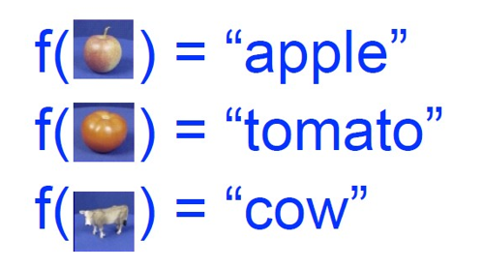
How it is done? The Machine Learning Framework
Apply a prediction function to a feature representation of the image to get the desired output

Slide 29
The Machine Learning Framework
y = f(x)
output
prediction function
Image feature
Training: given a training set of labeled examples {(x₁,y₁), …, (x_{N},y_{N})}, estimate the prediction function f by minimizing the prediction error on the training set
Testing: apply f to a never before seen test example x and output the predicted value y = f(x)

Slide 30


Steps
Training
Training Labels
Training Images
Image Features
Learned model
Training
Testing
Image Features
Learned model
Prediction
Test Image
Slide credit: D. Hoiem and L. Lazebnik

Slide 31
The Essence of Machine Learning
A pattern exists
We cannot pin it down mathematically
We have data on it
Notes:
A pattern exists. For example: pattern for rose flowers: red, large petals, sweet smelling (features). Or in time series: every dec flooding because
Why not maths? Knp nak susah2.. Sbb 2 + 2 = 4

Slide 32
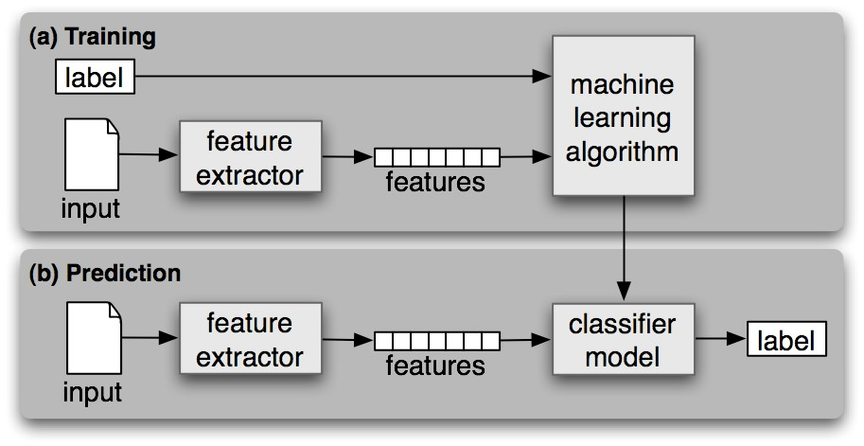
Typical Learning Process

Slide 33
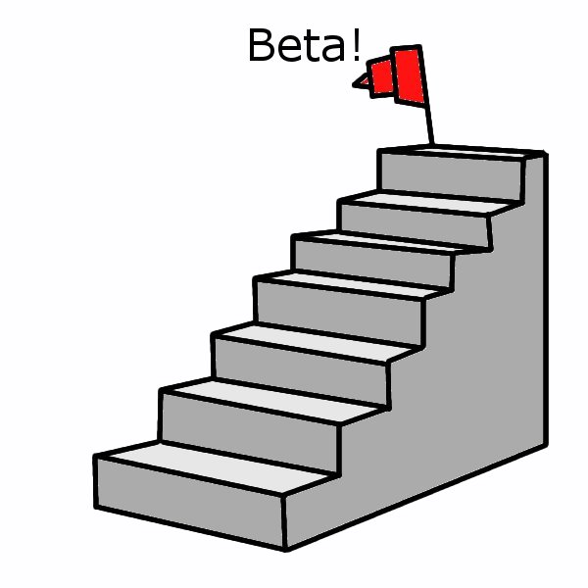
Steps of applying ML:-
Data Collection
Data Preprocessing
Data Cleaning
Data Transformation
Divide data into training and testing sets
Built a model learning ( use training data)
Model Evaluation (use test data)
If the performance is satisfying, deploy to the real system.
- Feature Extraction
- Feature Selection
Notes:
http://www.aboutdm.com/2013/03/basic-steps-of-applying-machine.html
1. Data Collection: At this stage, we want to collect all relevant data. For an online business, user click, search queries, and browsing information should be all be captured and saved into the database. In manufacturing, log data capture machine status and activities. Such data are used to produce maintenance schedules and predict required parts for replacement. 2. Data Preprocessing: The data used in Machine Learning describes factors, attributes, or features of an observation. Simple first steps in looking at the data include finding missing values. What is the significance of that missing value? Would replacing a missing data value with the median value for the feature be acceptable? For example, perhaps the person filling out a questionnaire doesn't want to reveal his salary. This could be because the person has a very low salary or a very high salary. In this case, perhaps using other features to predict the missing salary data might be appropriate. One might infer the salary from the person’s zip code. The fact that the value is missing may be important. There are machine learning methods that ignore missing values and one of these could be used for this data set. 2) Data Transformation: In general we work with both numerical and categorical data. Numerical data consists of actual numbers, while categorical data have a few discrete values. Examples of categorical data include eye color, species type, marriage status, or gender. Actually a zip code is categorical. The zip code is a number but there is no meaning to adding two zip codes. There may or may not be an order to categorical data. For instance good, better, best is descriptive categorical data which has an order. 3) After the data has been cleaned and transformed it needs to be split into a training set and a test set. 3. Model Building: This training data set is used to create the model which is used to predict the answers for new cases in which the answer or target is unknown. For example, Section 1.3 describes how a decision tree is built using the training data set. Several different modeling techniques have been introduced and will be discussed in detail in future sections. Various models can be built using the same training data set. 4. Model Evaluation Once the model is built with the training data, it is used to predict the targets for the test data. First the target values are removed from the test data set. The model is applied to the test data set to predict the target values for the test data. The predicted value of the target is then compared with the actual target value. The accuracy of the model is the percentage of correct predictions made. These accuracies of can be used to compare the different models. Several other ways to compare model accuracy are discussed in the next section on Performance Evaluation. 5. Model Deployment: This is the most important step. If the speed and accuracy of the model is acceptable, then that model should be deployed in the real system. The model that is used in production should be made with all the available data. Models improve with the amount of available data used to create the model. The results of the model need to be incorporated in the business strategy. Data mining models provide valuable information which give companies great advantages. Obama won the election in part by incorporating the data mining results into his campaign strategy. The last chapter of this book provides information in how a company can incorporate data mining results into its daily business.

Slide 34
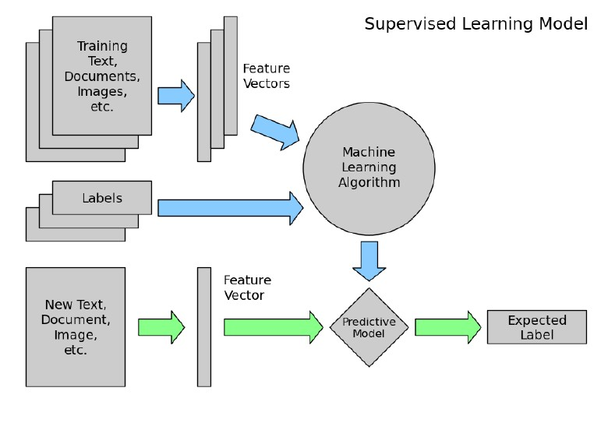

Slide 35
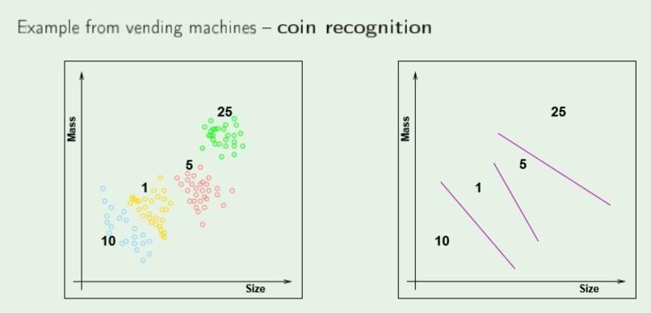
Example : Supervised Learning

Slide 36
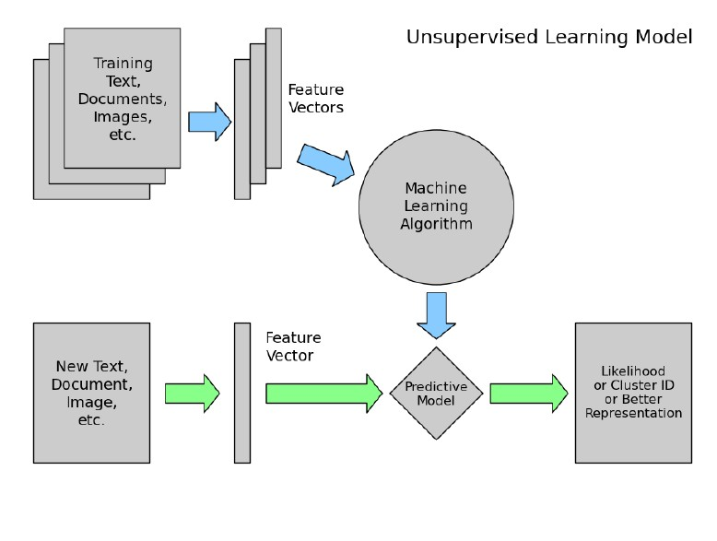

Slide 37
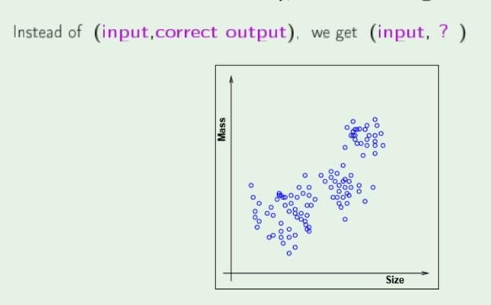
Example : Unsupervised Learning

Slide 38
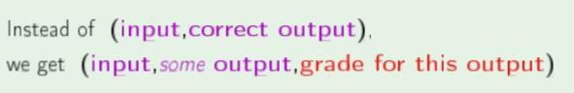
Reinforcement Learning

Slide 39
Representation Learning (1)
The problem of classical ML methods are they are very depending on the right features
For many tasks, however, it is diﬃcult to know what features should be extracted. For example, suppose that we would like to write a program to detect cars in photographs. We know that cars have wheels, so we might like to use the presence of a heel as a feature. Unfortunately, it is diﬃcult to describe exactly
what a wheel looks like in terms of pixel values.

Slide 40
Representation Learning (2)
Machine learning to discover not only the mapping from representation to output but also the representation itself
Example: autoencoders

Slide 41
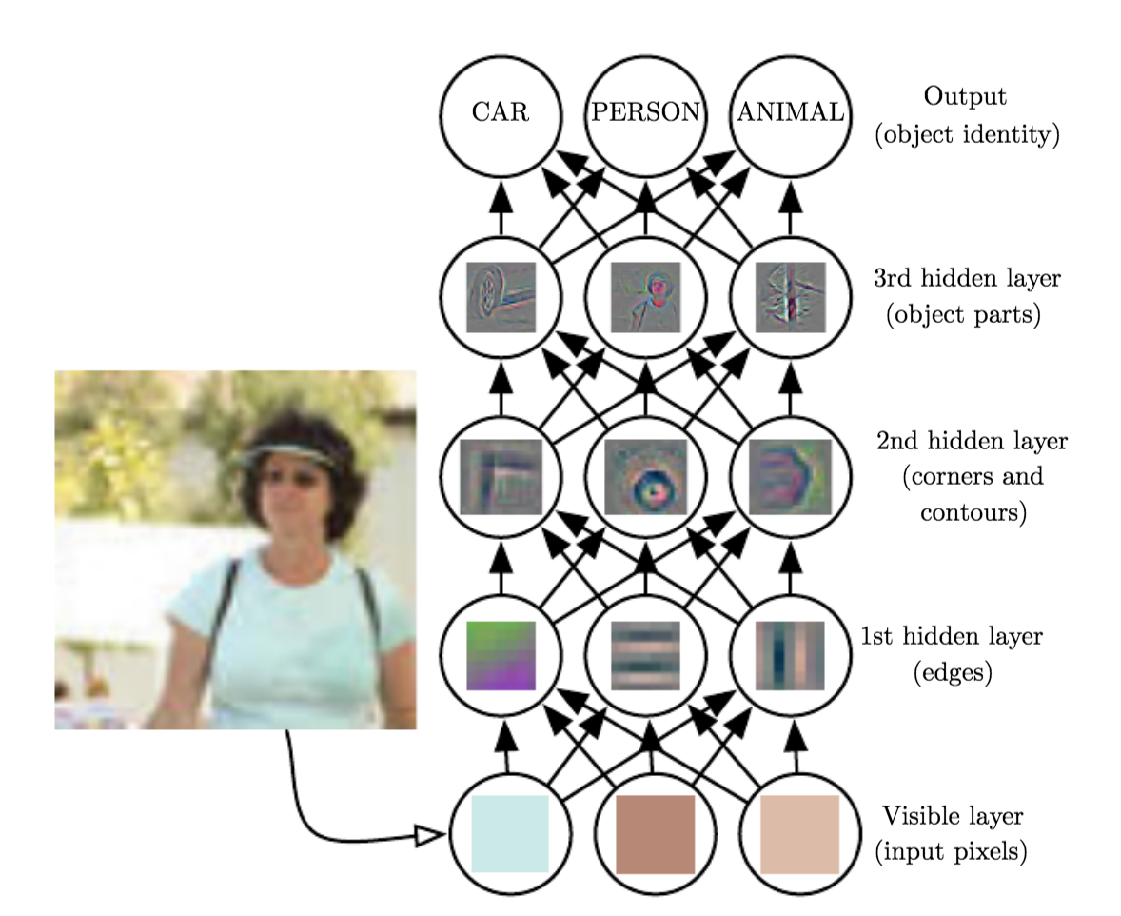
Deep Learning
Deep Learning

Slide 42
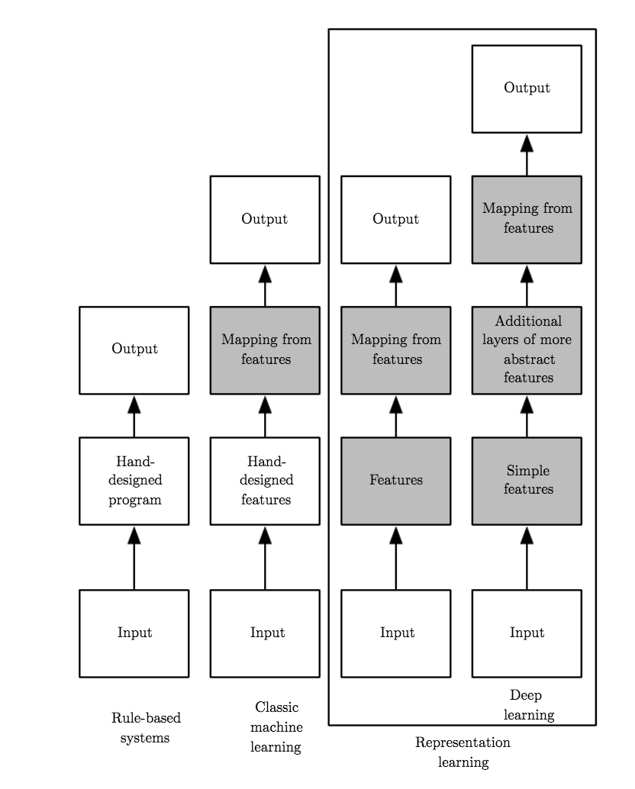
Logistic Regression
Naïve-Bayes

Slide 43
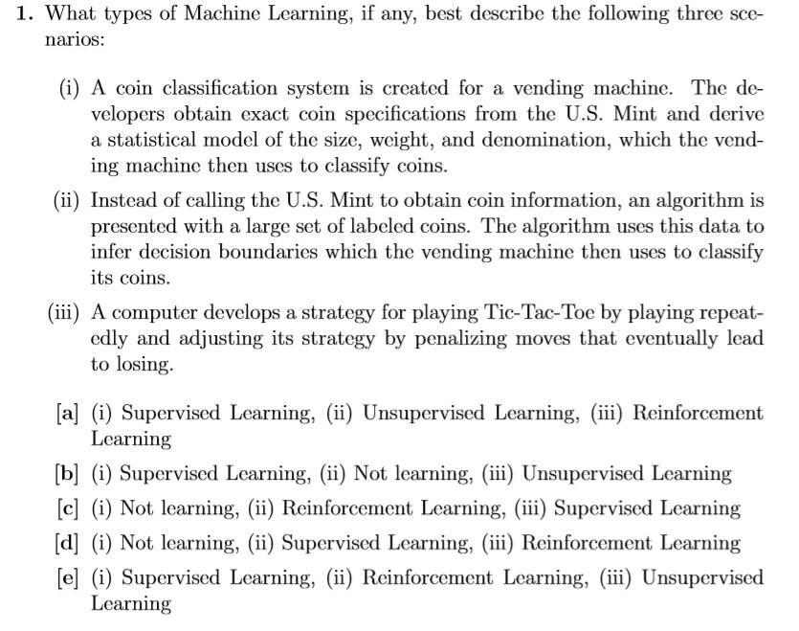
Problem 1:

Slide 44
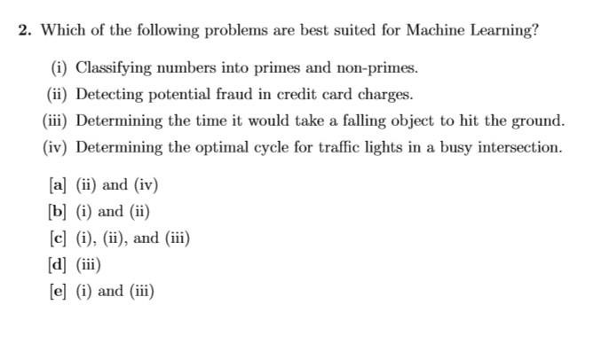
Problem 2:

Slide 45
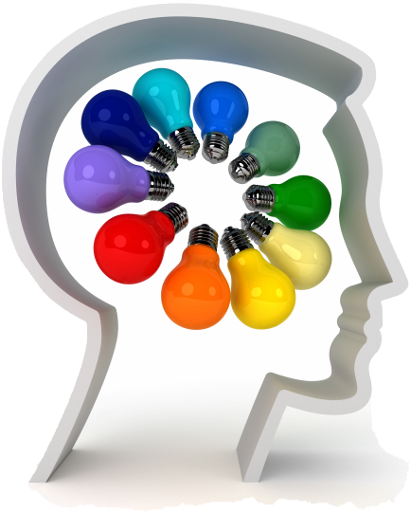
Buzz Session!!

Slide 46
Buzz Sessions E-learning Participation-Discussion 1
List and explain five(5) reasons why machine learning is important to our daily life?
Do you think having the best machine learning model is the most crucial part?
What are the three (3) ways machine learning is helping mobile advertiser and give the examples of the application.

Slide 47
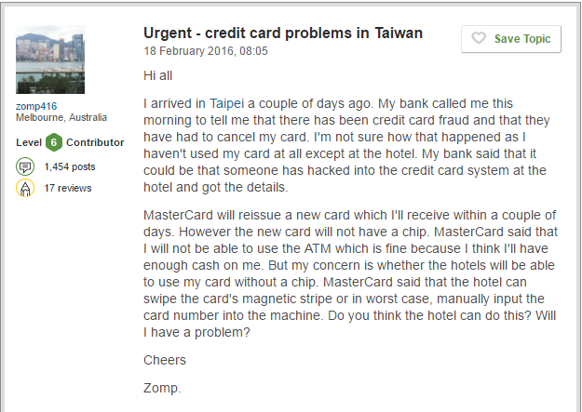
Assignment 1: Due Submission :
Figures 1 shows an example of the credit card fraud issue happen in Taiwan. In well-developed financial system, crisis management is on downstream and risk prediction is on the upstream. In recent years, the credit cards issuers in Taiwan face the debt and credit card crisis. The crisis caused the blow to consumer finance confidence and big challenge for both bank and card holderA full description is available at the site where the data was obtained from:
http://archive.ics.uci.edu/ml/datasets/default+of+credit+card+clients
Here are the data for the project:
http://archive.ics.uci.edu/ml/machine-learning-databases/00350/
QUESTION:
What problem can you solve with these data?
Is this a machine learning problem?
What is the x and the y?
Figure 1. Credit card problem in Taiwan
(https://www.tripadvisor.com.my/ShowTopic-g293910-i9303-k9274267- urgent_credit_card_problems_in_Taiwan-Taiwan.html )
**Please answer all the given question. Your answer should be based on the powerpoint slide presentation.

Slide 48
Thanks!
Siti Sophiayati Yuhaniz, PhD
Machine Learning for Data Science Interest Group Advanced Informatics School Universiti Teknologi Malaysia
@utmmlds
ais.utm.my/mlds
September 2017
Some slides are taken from:
Hands on Machine Learning with Scikit-Learn and Tensorflow book

